Slide 1
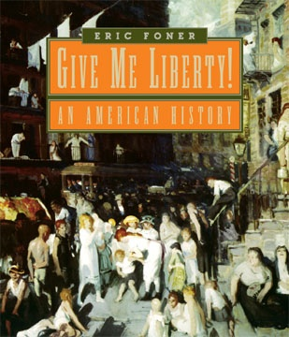
Chapter 3
Norton Media Library
Chapter 3
Crisis and Expansion:
North American
Colonies, 1650–1750
Eric Foner

Slide 2
I. Pueblo Revolt of 1680
Inquisition
  Successful Pueblo rebellion against the Spanish in 1680
  Spain learned a lesson in tolerance

Slide 3
II. Empires in Conflict
The Dutch Empire
  Henry Hudson claimed New York for the Netherlands in 1609
  By the early seventeenth century, the Netherlands was a formidable trading empire and banking center
  The Dutch came to North America to trade, not to conquer
  Dutch authorities recognized Indian sovereignty over the land and forbade settlement in any area until it had been purchased

Slide 4
II. Empires in Conflict (con’t)
Freedom in New Netherland
  New Netherland was not governed democratically
  Slaves enjoyed half-freedoms
  Women enjoyed liberties not bestowed upon English women, including retaining their legal identity after marriage
  Religious freedoms were extensive, with toleration extended to Catholics and Jews
  Large estates were offered to patroons, who could run their estate like a medieval lord
    Kiliaen Van Rensselaer

Slide 5
II. Empires in Conflict (con’t)
French Colonization
  By the late seventeenth century, France had claims arching from St. Lawrence to New Orleans
  Migration to New France was largely by men, with fewer than 20 percent women and only 250 complete families
  The French government feared that significant emigration to the New World would undermine France’s role as a European great power

Slide 6
II. Empires in Conflict (con’t)
New France and the Indians
  Since New France relied upon fur trade with the Indians, the French tried to develop friendly relations with the local Indians
    The result was some of the most enduring alliances between Indians and settlers in colonial North America
  Contact with the French brought devastating disease to the Indians
  The French were much more accepting of Indians into colonial society than the British

Slide 7
III. The Expansion of England’s Empire
The Mercantilist System
  England attempted to regulate its economy to ensure wealth and national power
    Commerce was the foundation of empire, not territorial plunder
  The Navigation Acts required colonial products to be transported in English ships and sold at English ports

Slide 8
III. The Expansion of England’s Empire (con’t)
The Conquest of New York
  The New Netherlands was seized in 1664 during an Anglo-Dutch war
  The terms of Dutch surrender guaranteed some freedoms and liberties, but reversed others
  The Duke of York governed New York and by 1700 nearly 2 million acres of land was owned by only five New York families

Slide 9
III. The Expansion of England’s Empire (con’t)
  The English briefly held an alliance with the Five Nations, known as the Covenant Chain, but by the end of the century the Five Nations adopted a policy of neutrality
  Demanding “liberties,” the English of New York got an elected assembly, which drafted its Charter of Liberties and Privileges in 1683

Slide 10
III. The Expansion of England’s Empire (con’t)
The Founding of Carolina
  Carolina was established as a barrier to Spanish expansion north of Florida
  Carolina was an offshoot of Barbados and, as such, a slave colony from the start
  The Fundamental Constitution of Carolina established a feudal society, but did allow for religious toleration and an elected assembly

Slide 11
III. The Expansion of England’s Empire (con’t)
The Holy Experiment
  Pennsylvania was the last seventeenth-century colony to be established and was given to proprietor William Penn
  A Quaker, Penn envisioned a colony of peaceful harmony between colonists and Indians and a haven for spiritual freedom

Slide 12
III. The Expansion of England’s Empire (con’t)
Quaker Liberty
  Quakers believed that liberty was a universal entitlement
    Liberty extended to women, blacks, and Indians
  Religious freedom was a fundamental principle
    Quakers upheld a strict moral code
  Pennsylvania prospered under Penn’s policies

Slide 13
IV. Colonies in Crisis
Bacon’s Rebellion
  Virginia’s government ran a corrupt regime
    Good, free land was scarce for freed servants
    Taxes on tobacco rose as price fell
  Frontier settlers demanded:
    that the governor remove the colony’s Indians to open up land
    reduction of taxes
    end of rule by the elite
  Bacon spoke of traditional English liberties
  Aftermath left Virginia’s planter-elite to consolidate their power and improve their image

Slide 14
IV. Colonies in Crisis (con’t)
King Philip’s War
  In 1675 King Philip and his forces attacked nearly forty-five New England towns
  The settlers counterattacked in 1676, breaking the Indians’ power once and for all

Slide 15
IV. Colonies in Crisis (con’t)
The Glorious Revolution
  The Glorious Revolution in 1688 established Parliamentary supremacy and secured the Protestant succession to the throne
  Rather than risk a Catholic succession through James II, the Dutch Protestant William of Orange was asked to assume the throne
  The overthrow of James II entrenched the notion that liberty was the birthright of all Englishmen
    Parliament issued a Bill of Rights in 1689

Slide 16
IV. Colonies in Crisis (con’t)
The Glorious Revolution in America
  In 1675, England established the Lords of Trade to oversee colonial affairs but the colonies were not interested in obeying London
  To create wealth, James II created a super-colony, the Dominion of New England, between 1686 and 1685
    The new colony threatened liberties
  News of the Glorious Revolution resulted in a reestablishment of former colonial governments
    Lord Baltimore was overthrown in Maryland
    Jacob Leisler took control of New York

Slide 17
IV. Colonies in Crisis (con’t)
  In New England, Plymouth was absorbed into Massachusetts, transforming the political structure of the colony
    Land ownership, not church membership, was required to vote
    Governor appointed in London rather than elected
    Colony had to abide by the Toleration Act
Witchcraft in New England
  Witchcraft was widely believed in and punishable by execution
  Most accused were women

Slide 18
IV. Colonies in Crisis (con’t)
The Salem Witch Trials
  In 1691 several girls named Tituba as a witch
  Accusation snowballed until, in the end, fourteen women and five men were hanged
  Increase Mather published “Cases of Conscience”

Slide 19
V. The Eighteenth Century: A Growing Society
A Diverse Population
  As England’s economy improved, large-scale migration was draining labor from the mother country
    Efforts began to stop emigration
  Convicts were sent to North America
  145,000 Scots and Scots-Irish immigrants came to North America
The German Migration
  Germans, 110,000 in all, formed the largest group of newcomers from the European continent
  Their migration greatly enhanced the ethnic and religious diversity of Britain’s colonies

Slide 20
V. The Eighteenth Century: A Growing Society (con’t)
Religious Diversity
  Eighteenth-century British America was very diverse, host to many religions
  Other liberties also attracted settlers
    availability of land
    lack of a military draft
    absence of restraints on economic opportunity

Slide 21
V. The Eighteenth Century: A Growing Society (con’t)
Settlers and Indians
  Indian communities were well integrated into the British imperial system
  Traders, British officials, and farmers all viewed Indians differently
  The Walking Purchase of 1737 brought fraud to Pennsylvania Indians

Slide 22
V. The Eighteenth Century: A Growing Society (con’t)
Colonial Society
  The backcountry was the most rapidly growing region in North America
  Farmers in the older portions of the Middle Colonies enjoyed a standard of living unimaginable in Europe
    Pennsylvania was “the best poor man’s country”
The Consumer Revolution
  Great Britain eclipsed the Dutch in the eighteenth century as a leader in trade
  Eighteenth-century colonial society enjoyed a multitude of consumer goods

Slide 23
V. The Eighteenth Century: A Growing Society (con’t)
Colonial Cities
  Although relatively small and few in number, port cities like Philadelphia were important
  The city was home to a large population of artisans
    Myer Myers
An Empire of Commerce
  Trade unified the British Empire

Slide 24
VI. Social Classes in the Colonies
The Colonial Elite
  Expanding trade created the emergence of a powerful merchant upper class
  In the Chesapeake and Lower South, planters accumulated enormous wealth
  America had no titled aristocracy or established social ranks
  By 1770 nearly all upper-class Virginians had inherited their wealth

Slide 25
VI. Social Classes in the Colonies (con’t)
Anglicization
  Colonial elites began to think of themselves as more and more English
  Desperate to follow an aristocratic lifestyle, many planters fell into debt
  The richest group of mainland colonists were South Carolina planters
  The tie that held the elite together was the belief that freedom from labor was the mark of the gentleman

Slide 26
VI. Social Classes in the Colonies (con’t)
Poverty in the Colonies
  Although poverty was not as widespread compared to England, many colonists had to work as tenants or wage labors because access to land diminished
  Taking the colonies as a whole, half of the wealth at mid-century was concentrated in the hands of the richest 10 percent of the population
  The better-off in society tended to view the poor as lazy and responsible for their own plight
    Communities had policies to warn out undesirables

Slide 27
VI. Social Classes in the Colonies (con’t)
The Middle Ranks
  Many in the nonplantation South owned some land
  By the eighteenth century, colonial farm families viewed land ownership almost as a right, the social precondition of freedom
Women and the Household Economy
  Family was the center of economic life and all members contributed to the family’s livelihood
  The work of farmers’ wives and daughters often spelled the difference between a family’s self-sufficiency and poverty

Slide 28
VI. Social Classes in the Colonies (con’t)
North America at mid-century
  Colonies were diverse with economic prosperity and many liberties compared to Europe

Slide 29
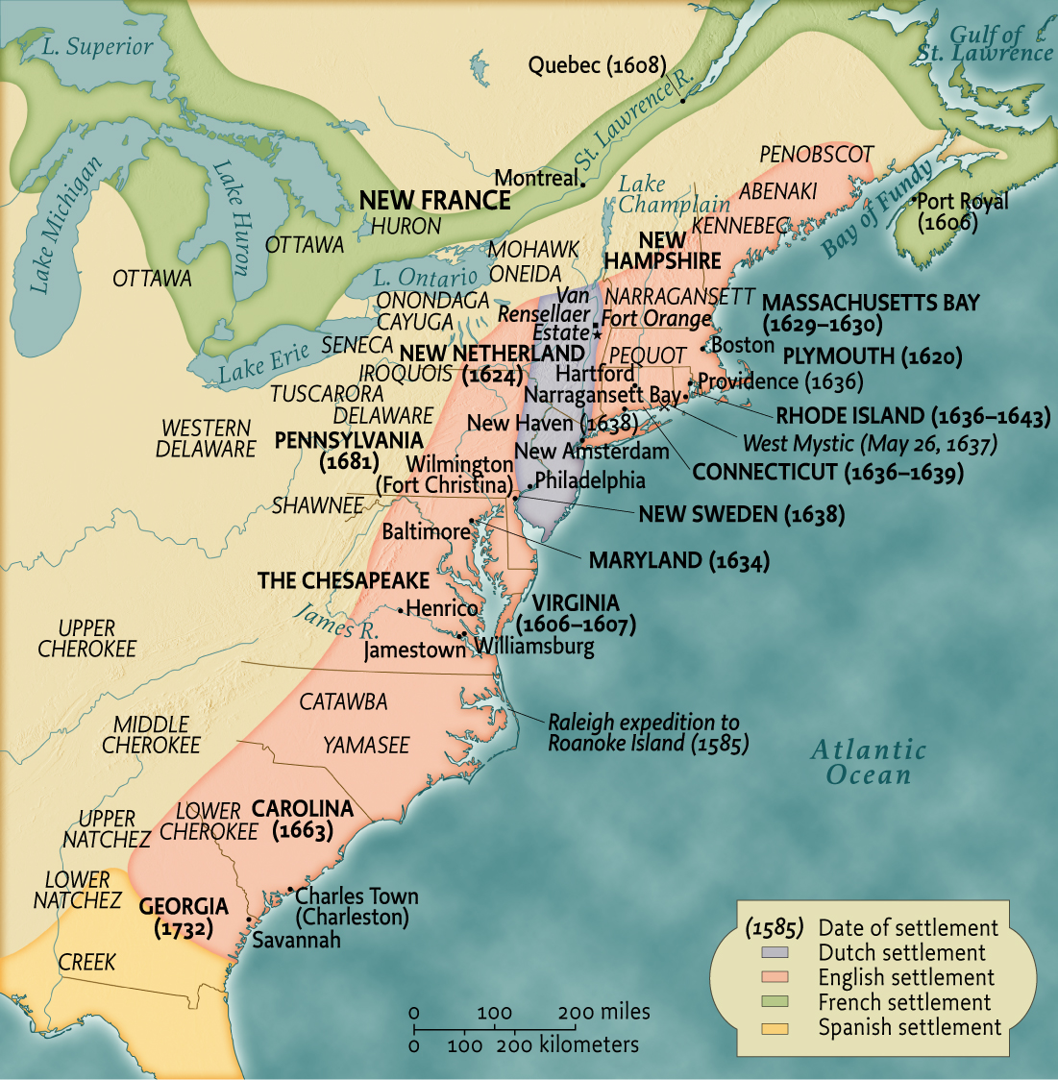
Eastern North America in the Seventeenth and Early Eighteenth Centuries • pg. 86
Eastern North America
in the Seventeenth and Early
Eighteenth Centuries

Slide 30
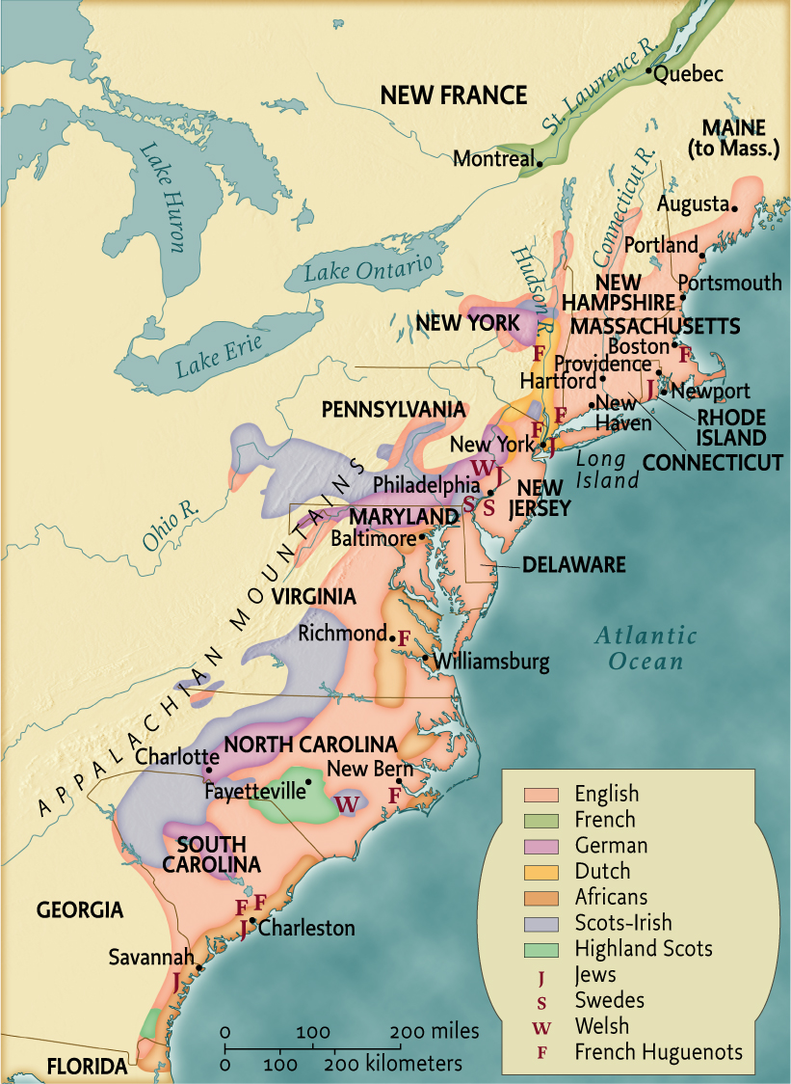
European Settlement and Ethnic Diversity on the Atlantic Coast of North America, 1760 • pg. 102
European Settlement
and Ethnic Diversity
on the Atlantic Coast
of North America, 1760

Slide 31
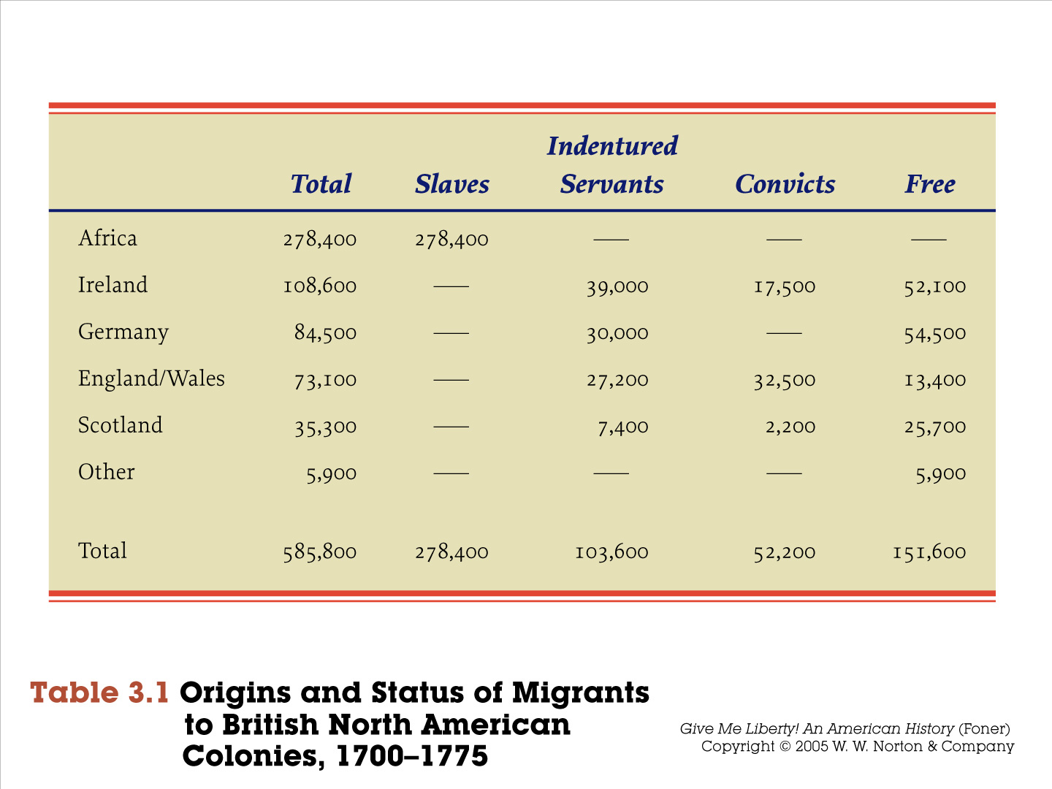
Table 3.1 • pg. 105

Slide 32
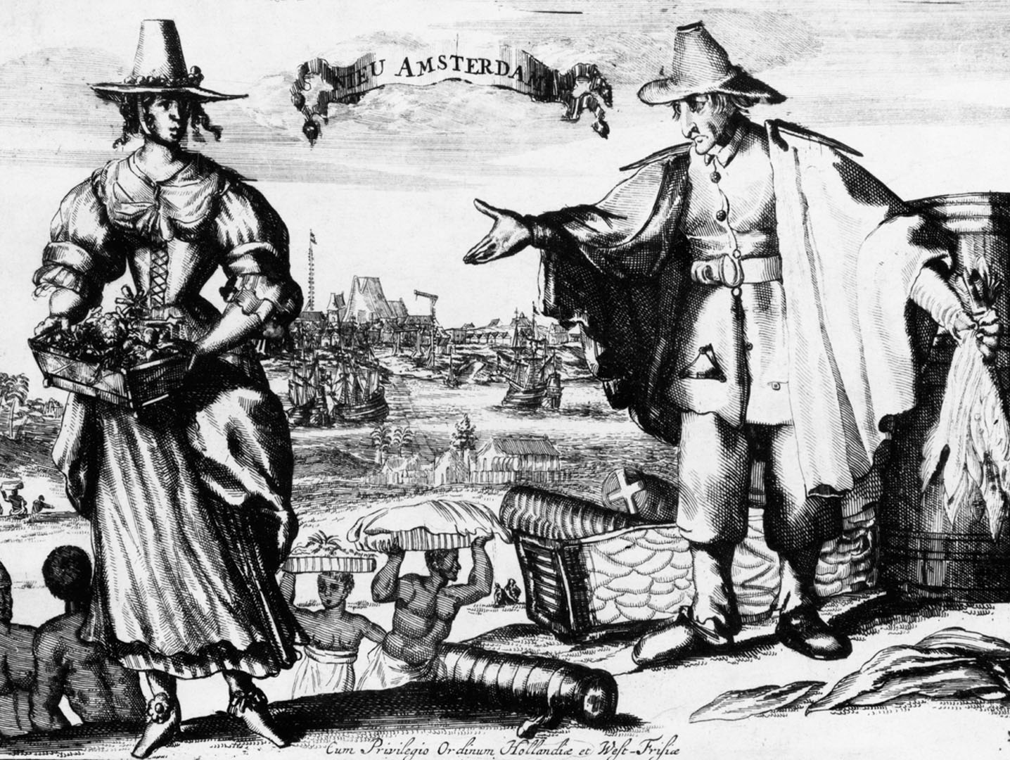
fig03_05.jpg
Notes:
Page 84: Another engraving of New Amsterdam made around 1650 depicts ships involved in transatlantic trade and slaves at work.
Bettmann/Corbis

Slide 33
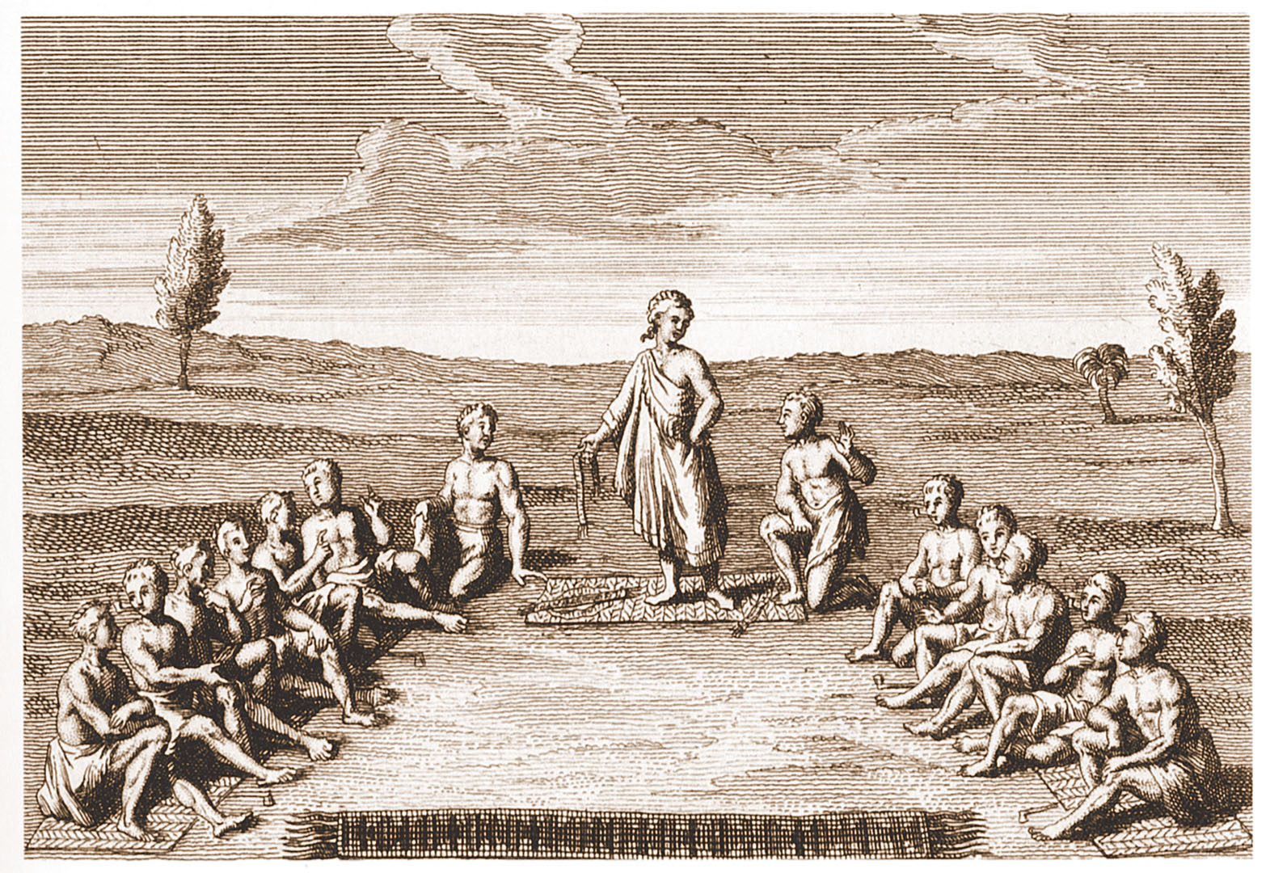
fig03_06.jpg
Notes:
Page 89: An engraving representing the Great Council of the Five Iroquois Nations of present-day upstate New York. From a book about American Indians published in Paris in 1724 by a Jesuit missionary.
Reproduced from the Collection of the Library of Congress, MSS E58.L16

Slide 34
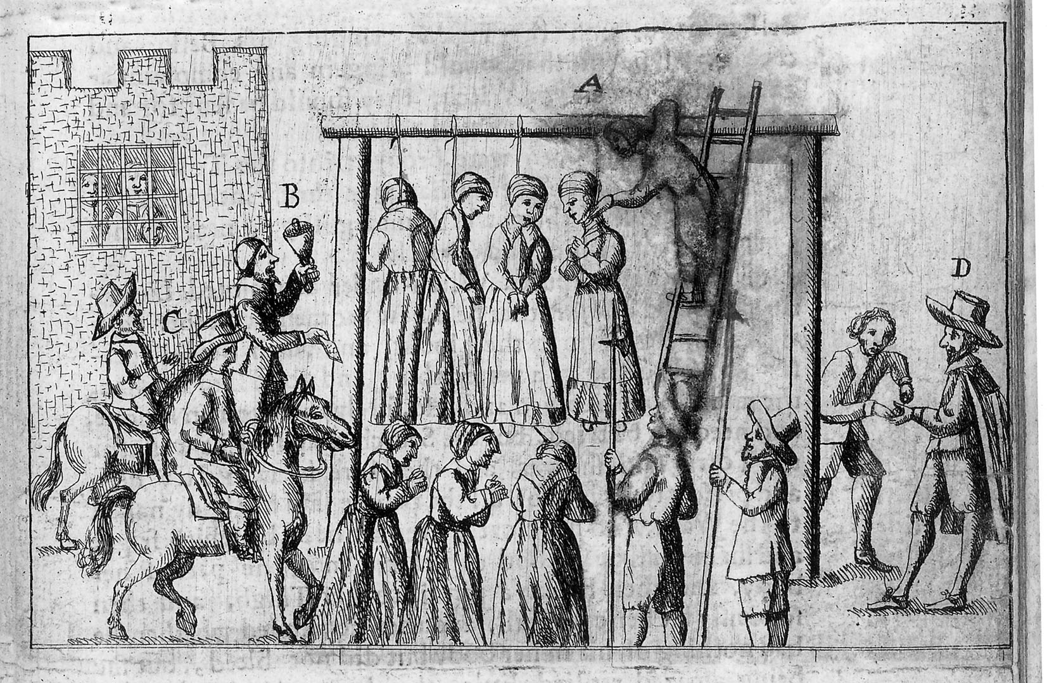
fig03_10.jpg
Notes:
Page 100: Women hanged as witches in seventeenth-century England. The letters identify local officials: A is the hangman, B the town crier, C the sheriff, and D a magistrate. An engraving from Ralph Gardiner’s, England’s Grievance Discovered, published in 1655.
Rare Books Dividsion, The New York Public Library, Astor, Lenox and Tilden Foundations

Slide 35
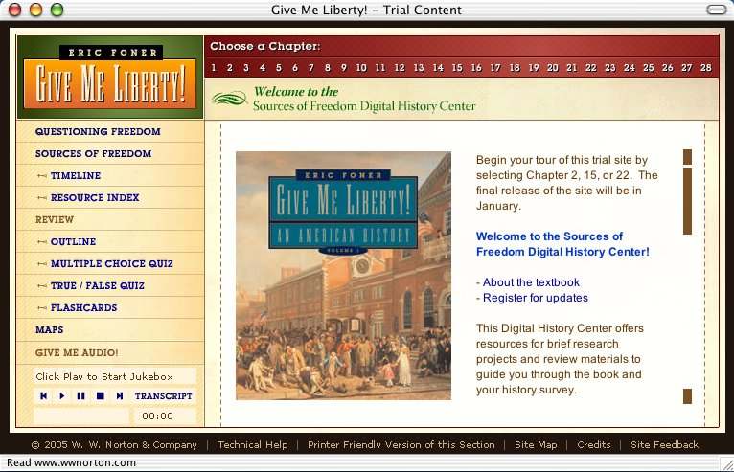
Go to website
http://www.wwnorton.com/foner/

Slide 36
End chap. 3
This concludes the Norton Media Library
Slide Set for Chapter 3
Give Me Liberty!
An American History
by
Eric Foner
W. W. Norton & Company
Independent and Employee-Owned

